Slide 1
Project Go-clean
CMPT 2400
Project Part 2: Consolidating Data & Feature Engineering

Slide 2
Which industry reported the most spills and predict the number of spills that will occur in 2023, and the total amount spilled. ​
Presented by
Dionathan dos Santos
Harshdeep Kaur
Navkirat Singh
Rajveer Singh
Vinit Kataria

Slide 3
Aligning Datasets
The NPRI and GDP datasets were aligned using reporting_year_année and province as keys.
Adjustments:
Cleaned GDP values (gdp_market_prices) by removing commas and converting them to float.
Ensured data compatibility by cleaning and type-casting (e.g., categorical types for provinces and numerical types for spill counts).
Missing columns like units were identified and added as necessary.

Slide 4
Merging Datasets
Successfully merged GDP and NPRI datasets using the shared keys (reporting_year_année, province).
Removed unnecessary columns like duplicate Province or Year.
Handled NaN values in gdp_market_prices through imputation or exclusion.

Slide 5
Feature Encoding
Minimal encoding is required due to the dominance of numerical features in the dataset (e.g., spill counts, GDP).
Applied:
Label Encoding for categorical variables like naics_title_titre_code_scian and substance_name_english_nom_de_substance_anglais.
Mapped categorical spill types (e.g., release_to_air_spills) into broader categories: Air, Land, Water.

Slide 6
Normalization
Used StandardScaler to standardize numerical features, such as:
Lagged spill values (sum_of_release_lag1, lag2, lag3).
GDP values (gdp_market_prices).
Applied the scaler consistently across training, validation, and test sets.
Reason for StandardScaler:
Less sensitive to outliers compared to MinMaxScaler.
Ensured features like GDP (large scale) and spill counts (small scale) were treated equally in the model.
Justification:
Improved model performance by ensuring no single feature dominated due to scale differences.

Slide 7
Feature Engineering
Lagged Features: Created (sum_of_release_lag1, lag2, lag3) to capture temporal dependencies in spill data.
Unit Standardization: Converted spill values into tonnes for consistency.
Risk Categories: Engineered spill_risk_category by classifying total spills into High, Medium, and Low risk levels based on quantiles.
Notes:
Feature Engineering Overview: When dealing with environmental data, it’s crucial to prepare and refine the input variables so the predictive models can capture the right patterns. In this step, I focused on three key techniques to improve the model’s learning capabilities and its overall accuracy.
Lagged Features: To incorporate temporal patterns and better understand how past releases influence current pollution levels, I created lagged features. Specifically, I generated variables like sum_of_release_lag1, sum_of_release_lag2, and sum_of_release_lag3—each representing the total pollutant release from one, two, and three time periods prior, respectively. Rationale: Lagged features help the model recognize trends over time, such as persistent leakage issues or seasonal spikes in pollutant releases.
Unit Standardization: I also standardized units of measurement by converting all spill values into a common unit—tonnes. This was done to ensure consistency across different data sources and measurement systems. Rationale: Uniform measurement units prevent the model from misinterpreting differences simply because of varied units, thereby improving data comparability and reliability.
Risk Categories: Lastly, I introduced a categorical feature to represent the relative severity of total spills. By using quantiles, I divided the total spill amounts into three categories—High, Medium, and Low risk. Rationale: Creating a risk category allows the model, or the analysis, to quickly identify which sites or periods are associated with severe pollution events, enabling targeted interventions or more nuanced predictions regarding environmental impact and regulatory compliance.
Summary: These engineered features—lagged time-series variables, standardized units, and a risk-based classification—collectively enhance the predictive modeling process. They help surface temporal trends, ensure consistent measurement standards, and highlight the magnitude of environmental risks, ultimately leading to more informed decisions and a clearer understanding of the data’s underlying patterns.

Slide 8
Feature Selection
Calculated Pearson Correlation to identify features most correlated with the target variable (sum_of_release_to_all_media_tonne).
Retained domain-relevant features like:
GDP values (gdp_market_prices).
Lagged spill counts (sum_of_release_lag1, lag2).
Industry classifications (naics_code_scian).
Notes:
Feature Selection Overview: After creating new features, the next step was to identify which ones are the most significant for predicting pollutant release patterns. This ensures that the model remains efficient and avoids overfitting by using only the most relevant data points.
Pearson Correlation Analysis: To achieve this, I calculated the Pearson Correlation for all features. This method measures the linear relationship between each feature and the target variable, which in this case is sum_of_release_to_all_media_tonne. Rationale: Pearson Correlation is a straightforward and effective way to filter features by their predictive strength, ensuring only those with the highest impact are retained.
Retained Features: Based on this analysis, I retained the following key features that are both statistically significant and domain-relevant:
GDP Values (gdp_market_prices): This reflects the economic activity and its potential influence on industrial releases.
Lagged Spill Counts (sum_of_release_lag1, lag2): These provide historical context and capture temporal dependencies in spill behavior.
Industry Classifications (naics_code_scian): This indicates the industrial sectors responsible for the releases, offering a critical link between the source and the target variable.
Summary: The combination of these features ensures a balance between statistical significance and practical domain relevance. They collectively provide the model with diverse perspectives—economic, temporal, and industry-specific insights—allowing for a comprehensive understanding of pollutant release patterns. This process ensures that only the most valuable predictors are used, improving the model's efficiency and accuracy.

Slide 9
Why StandardScaler over MinMaxScaler?
Advantages of StandardScaler:
Outliers: Less sensitive to outliers, preserving data integrity for spill volumes with extreme values.
Scale Independence: StandardScaler centers features at a mean of 0 and scales to unit variance, maintaining proportionality.
Drawbacks of MinMaxScaler:
Compresses data into a 0–1 range, which:
Overemphasizes small-scale features.
Distorts scaling in the presence of outliers.
Conclusion:
StandardScaler was more appropriate given the dataset’s characteristics (e.g., outliers in spill volumes, large range differences between GDP and spill counts).

Slide 10
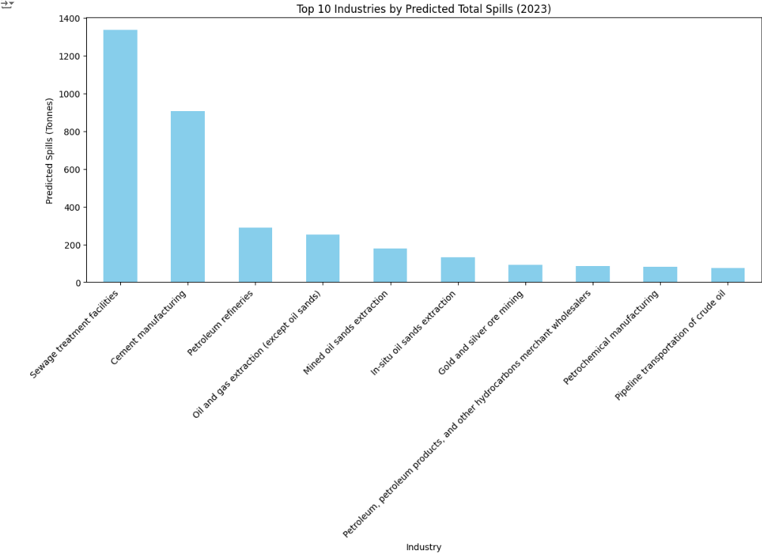
Top 10 Industries by Predicted Total Spills 2023
Sewage Treatment Facilities – Reported as the most spills for 2023

Slide 11
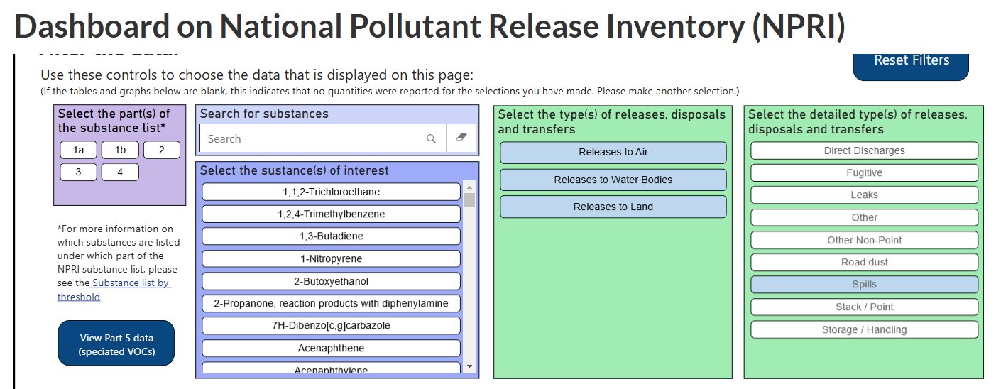
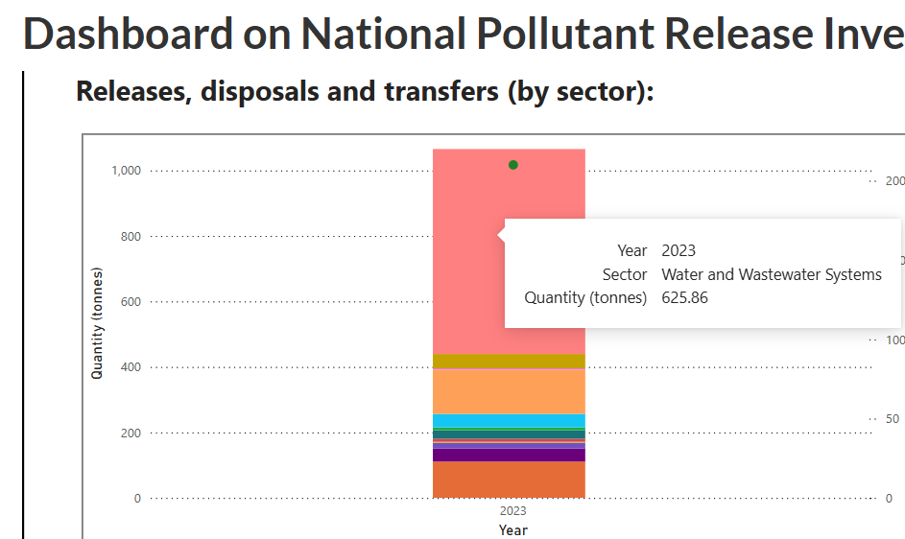
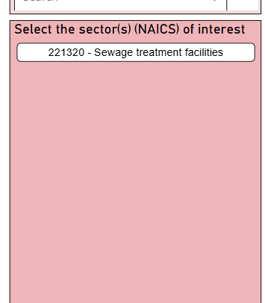
Model Accuracy Comparison
Our Prediction matches the industry that reported the most spills in 2023, according to the NPRI Official dashboard

Slide 12
Key Takeaways
The alignment and merging of NPRI and GDP datasets provided a robust foundation for analyzing the relationship between economic growth and environmental impact.
Feature engineering (lagged values, risk categories) and normalization (using StandardScaler) significantly enhanced the dataset’s predictive capacity.
Feature selection using Pearson correlation and domain knowledge ensured the model focused on impactful variables.

Slide 13
Thank you

